Slide 1
Welcome!
Sunday
Bible Study 9:30 AM
Worship 10:30 AM
PM Bible Class (Livestream) 5:00 PM
Wednesday
Bible Class 7:00 PM
www.SunsetchurchofChrist.net

Slide 2
John 7:19-36
Knowing who Jesus is and where He is from
Righteous judgment
The people observe and contemplate

Slide 3
John 7:19-36
What was “known” of the Messiah
He would be from Bethlehem
He would work particular miracles
He would be a Son of David
He would deliver Israel

Slide 4
John 7:19-36
What was “known” of the Messiah
What was missed
He would be God (Isa. 9:6)
He would be from Heaven
He would return to Heaven

Slide 5
John 7:19-36
The promise to leave again
The question of Jesus’ departure

Slide 6
John 7:37-53
Knowing who Jesus is and where He is from
Righteous judgment
The people observe and contemplate

Slide 7
Welcome!
Sunday
Bible Study 9:30 AM
Worship 10:30 AM
PM Bible Class (Livestream) 5:00 PM
Wednesday
Bible Class 7:00 PM
www.SunsetchurchofChrist.net

Slide 8
Opening Prayer
Song – 7 | George Watkins
Scripture Reading
Song – 402 | George Watkins
Song – 166 | George Watkins
Lord’s Supper
Song – 109 | George Watkins
Collection
Song – 390 | George Watkins
Lesson | Brian Haines
Song – 311 | George Watkins
Closing

Slide 9
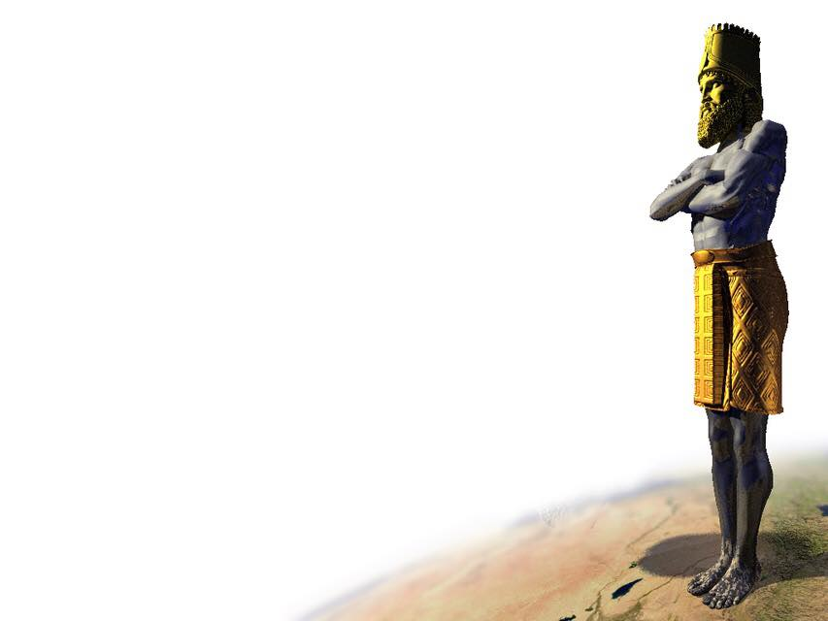
Daniel 3
"Shadrach, Meshach, and Abed-Nego; these men, O king, have not paid due regard to you. They do not serve your gods or worship the gold image which you have set up."

Slide 10
Daniel 3
“Our God whom we serve is able to deliver us from the burning fiery furnace, and He will deliver us from your hand, O king. But if not, let it be known to you, O king, that we do not serve your gods, nor will we worship the gold image which you have set up."
Notes:
The boldest statement in the Scriptures

Slide 11
Daniel 3
Refusing to submit to the idol
- Losing prestigious positions
- The offense of the nation
- The threat of horrific death
Deliverance unknown

Slide 12
Lessons From 3 Wise Men
1) We will all be challenged in Christ
2 Timothy 3:12 – Persecution
John 17:14 – Hatred
2 Timothy 1:8 – Embarrassment
Notes:
2Ti 3:12 Yes, and all who desire to live godly in Christ Jesus will suffer persecution. (YOU PICKED A SIDE IN A WAR)
Joh 17:14 "I have given them Your word; and the world has hated them because they are not of the world, just as I am not of the world (THE WORLD MUST HATE US)
2Ti 1:8 Therefore do not be ashamed of the testimony of our Lord, nor of me His prisoner, but share with me in the sufferings for the gospel according to the power of God,
1Pe 4:16 Yet if anyone suffers as a Christian, let him not be ashamed, but let him glorify God in this matter.(JESUS SAYS SOME HARD THINGS)

Slide 13
Lessons From 3 Wise Men
1) We will all be challenged in Christ
2) We cannot give in to fear
Hebrews 2:15 – Unafraid of death
Hebrews 13:6 – What can man do?
Notes:
Heb 2:15 and release those who through fear of death were all their lifetime subject to bondage. (CORONAVIRUS)
Heb 13:6 So we may boldly say: "The LORD is my helper; I will not fear. What can man do to me?“ (PERSECUTION)

Slide 14
Lessons From 3 Wise Men
1) We will all be challenged in Christ
2) We cannot give in to fear
3) God delivers
Matthew 28:20 – God knows us
2 Peter 2:4-9 – God knows how
Notes:
Mt 28:20 teaching them to observe all that I commanded you; and lo, I am with you always, even to the end of the age.“
2Ti 4:18 The Lord will deliver me from every evil deed, and will bring me safely to His heavenly kingdom; to Him [be] the glory forever and ever. Amen.

Slide 15
Lessons From 3 Wise Men
You need God on your side
You will be challenged in Christ
You will overcome if you stay committed
Notes:
Mt 28:20 teaching them to observe all that I commanded you; and lo, I am with you always, even to the end of the age.“
2Ti 4:18 The Lord will deliver me from every evil deed, and will bring me safely to His heavenly kingdom; to Him [be] the glory forever and ever. Amen.

Slide 17
Choosing Christ
Hearing and believing – Romans 10:17
Confession of Jesus – Romans 10:9
Repentance of sin – Romans 6:2
Baptism into Christ – Romans 6:3
Notes:
Ac 15:11 "But we believe that we are saved through the grace of the Lord Jesus, in the same way as they also are."

